Slide 1
Chain Link Security: Trends in Simultaneous HTTPS, ECH, and DNSSEC Use
Alexander Rhoads, Richard Ngeti, Yu-Siang Chou

Slide 2
Goals & Motivation: Surveying Usage of HTTPS, ECH, and DNSSEC
DNS HTTPS, ECH, and DNSSEC are relatively new and related web protocols.
ECH allows for the encryption of TLS handshakes, DNSSEC is a series of cryptographic signature protocols that ensure better integrity and authenticity of DNS records.
It could be advantageous to use DNSSEC in conjunction with HTTPS to authenticate records and prevent forgery, as well as to use it with ECH to authenticate handshake keys.
What will be the larger environment for deploying DNS HTTPS records with ECH and DNSSEC in 2026?
Notes:
Yu-Siang
DNS HTTPS, ECH, and DNSSEC are all relatively new and related web protocols. ECH allows for the encryption of TLS handshake that helps to prevent observers from seeing the domain name a client is connecting to, and DNSSEC is a series of cryptographic signature protocols that ensure better integrity and authenticity of DNS records. In addition, it’ could be advantageous to use DNSSEC in conjunction with HTTPS to authenticate records and prevent forgery, as well as to use it with ECH to authenticate handshake keys. Therefore, the main research problem in our paper is to answer what will be the larger environment for deploying DNS HTTPS records with ECH and DNSSEC in 2026.

Slide 3
Goals & Motivation: The 10,000 Domain Case Study
The previous studies of HTTPS that we draw from focus on very large data sets, where usually millions of domains are surveyed.
For both time purposes and to approach the data from a different angle, we’ll be surveying the top 10,000 domains.
Qualitatively and not just quantitatively, examining the top 10,000 domains is a different beast then examining the top 1,000,000. We cannot directly compare deployment values because of that.
The infrastructure and purpose of a top 10 domain is different than that of the bottom 10 out of 10,000 domains.
Extending that, the bottom 100 out of 10,000 domains is going to be different than the bottom 100 of 1,000,000 domains. Function, resources, and traffic affect the motivation behind security protocols.
Think of this as a case study of HTTPS, ECH, DNSSEC usage over the thin top layer of the 10,000 most visited domains of 2025.
Notes:
Alex

Slide 4
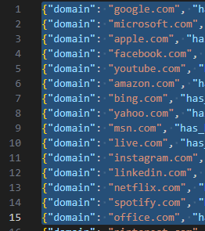
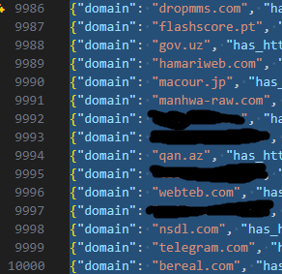
Top and Bottom 15 of 10,000 Domains
Notes:
Alex

Slide 5
Background: Hypertext Transfer Protocol Secure (HTTPS) & Transport Layer Security (TLS)
HTTPS is a layer security protocol used to send data between a web browser and website.
HTTPS uses TLS to provide data confidentiality or authentication between the client and the server.
TLS is the cryptographic protocol that provides encryption and authentication for HTTPS.
Notes:
Richie HTTPS secures communication between browsers and websites. It uses TLS encryption to protect data.
TLS ensures the connection is private and trustworthy.
When you see the lock icon in your browser, HTTPS and TLS are working together to encrypt your connection and keep your data private.

Slide 6
Background: HTTPS Parameters & Dynamic Configs
SvcPriority: The priority of the record relative to another record of the same name.
0: AliasMode, which aliases a domain name to the target domain.
Other values: ServiceMode, which provides information specific to a service endpoint
SvcParams
alpn (Application-Layer Protocol Negotiation): specifies additional application protocols.
ipv4hint/ipv6hint: suggest IPv4/IPv6 addresses for reaching the endpoint.
Dynamic Configurations
Occurs when at least one parameter uses an expression instead of a fixed value
<ftp:config name="ftp" defaultWriteEncoding="#[attributes.queryParams.encoding]">, <ftp:connection username="foo" password="mySecret" />, </ftp:connection>
Notes:
Richie
HTTPS DNS Parameters
SvcPriority: decides whether the record redirects a domain or provides service details.
ALPN: indicates supported web protocols.
IPv4/IPv6 hints: suggest server addresses.
Dynamic Config
Uses variable values instead of fixed ones to allow flexible configuration.
“HTTPS DNS records can include parameters that tell browsers how to connect to a service, such as which protocol to use or which IP addresses are available. Dynamic configuration means these settings can change automatically instead of being fixed.”

Slide 7
Background: Encrypted Client Hello (ECH)
Hides the identity of the target TLS server by encrypting the Server Name Indication (SNI) in the client Hello using the public key of the client-facing server.
The client-facing server can decrypt the ECH extension before forwarding the client Hello to the correct server.
Limits access to information that a particular user is visiting your website, obscuring them from intermediaries.
Notes:
Yu-Siang
Encrypted Client Hello, also known as ECH, hides the identity of the target TLS server by encrypting the Server Name Indication in the client Hello using the public key of the client-facing server, and the client-facing server can decrypt the ECH extension before forwarding the client Hello to the correct server. ECH also limits access to information that a particular user is visiting your website, obscuring them from intermediaries.

Slide 8
Background: Domain Name System Security Extensions (DNSSEC)
Specification suite designed to fortify DNS data with origin authentication, data integrity, and authenticated denial of existence.
Prevents DNS spoofing attacks by allowing authoritative name servers to sign RRsets using public-key cryptography.
DNSSEC resolver verifies that information originates from a legitimate server, and that data matches the information on authoritative DNS servers, by checking signatures in the DNSSEC servers’ response.
Notes:
Yu-Siang
The DNSSEC is a specification suite designed to fortify DNS data with origin authentication, data integrity, and authenticated denial of existence, and it prevents DNS spoofing attacks by allowing authoritative name servers to digitally sign RRsets using public-key cryptography. In the DNSSEC process, a DNSSEC resolver is used to verify that the information originates from a legitimate server and that the data matches the information on authoritative DNS servers by checking signatures in the DNSSEC servers’ response.

Slide 9
Approach
We queried the top 10,000 pay-level (no sub-domains) domains from over the course of 2025, as well as for each month of that year, using a list provided by the site Tranco.
We fetched information regarding the following Parameters:
HTTPS RR (Does the domain use HTTPS)
ECH Usage (Does the domain use HTTPS and ECH)
DNSSEC Usage (Does the Domain use HTTPS and DNSSEC)
SvcPriority Mode Used (Service or Alias Mode)
ALPN Usage
ipv4hint Usage
Ipv6hint Usage
Dynamic Configuration Usage
We extracted and calculated the data of each list, but we only had the resources to extract the information of the date of extraction.
Finalized data extraction occurred on March 7th, 2026.
Notes:
Alex

Slide 10
Approach Continued
We queried each domain using the library DNSPython to ask them what their HTTPS Resource Record said.
Additionally, we take that tally and calculate overall averages.
For qualitative analysis, we took lists from the extracted domains, organized by their protocol or parameter use (HTTPS + ECH, HTTPS + DNSSEC, etc.).
We then categorize them in two ways. First is site category, the broad category that describes a site, like a news site. Second is desired content, which describe the main type of content a user would seek from this site, like articles.
Notes:
Alex

Slide 11
Data Calculation Results
Domain/Protocol | HTTPS | HTTPS+ECH | HTTPS+DNSSEC | HTTPS+ECH+DNSSEC
Count | 2044 | 497 | 430 | 59
Share(%) | 20.44 | 4.97 | 4.30 | 0.59
Domain/HTTPS params & dynamic config | Alias mode | Service mode | alpn | ivp4 | ivp6 | Dynamic config
Count | 3 | 2041 | 2029 | 1977 | 1689 | 2037
Share(%) vs all domain | 0.03 | 20.41 | 20.29 | 19.77 | 16.89 | 20.37
Share(%) vs https domain | 0.14 | 99.85 | 99.27 | 96.72 | 82.63 | 99.66
Notes:
Yu-Siang
Here are the results from the top 10000 domains. In the top table, you can see that about 2000 domains have HTTPS protocol, 497 of them have HTTPS and ECH, 430 of them have HTTPS and DNSSEC, and only 59 of them have all three of the protocols. The table below shows the amounts and percentages of HTTPS parameters and dynamic configurations in all domains and HTTPS domains specifically.

Slide 12
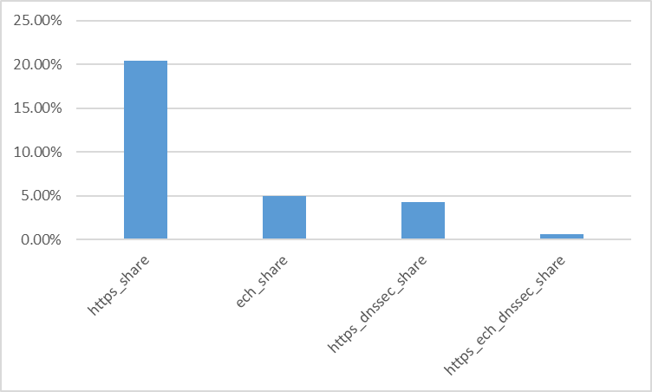
Simultaneous HTTPS, ECH, and DNSSEC usage
Notes:
Richie (Remember, ECH_share is both HTTPS and ECH)

Slide 13
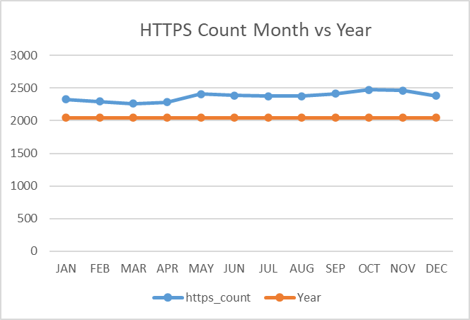
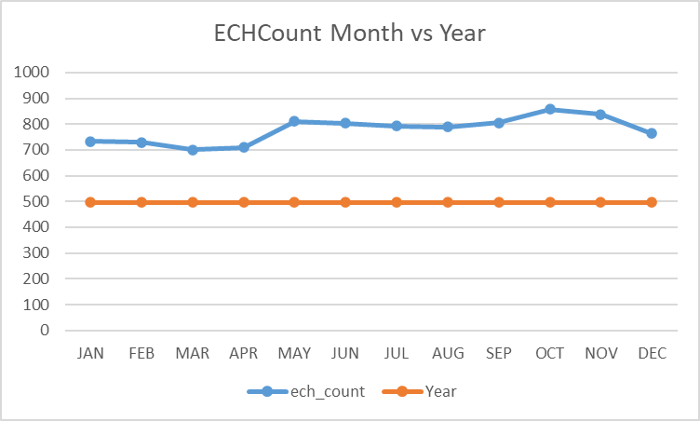
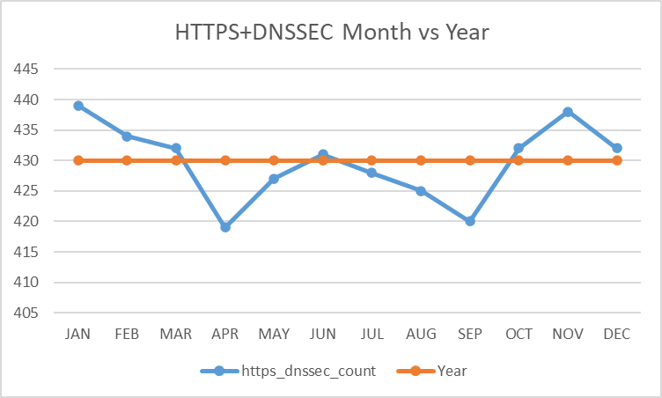
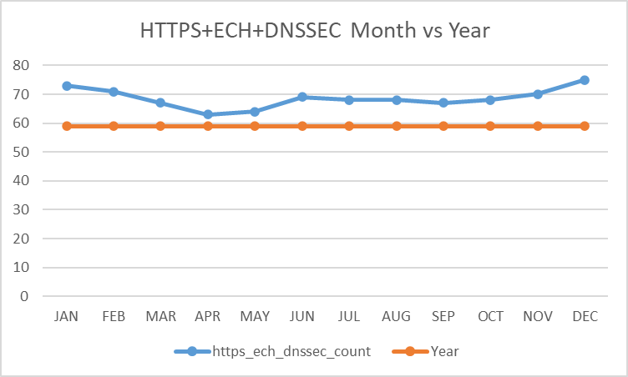
Stats on the Monthly Top 10,000 List
Notes:
Alex

Slide 14
Speculation: Why is DNSSEC Usage So Low?
Reading developer feedback, it seems that DNSSEC has a set of weaknesses [1]:
It’s difficult to implement and maintain, with key rollovers that can cause outages for domains if not handled correctly.
The infrastructure to support it, like client-side validators to check signatures, was just not there.
DNSSEC mostly protects the server-side records, not client-side, which a lot of users want. So it’s useful for high-security users, like banks.
Attractive alternative security methods overshadow it, like DNS over HTTPS, which encrypts DNS queries. [2] [3]
And all that with the extra resource costs to support the cryptology system means that it’s unattractive.
Notes:
Richie

Slide 15
Speculation: Why is ECH Usage So Low?
ECH requires coordinated support across DNS, TLS, and server infrastructure, so domains with less use cases are likely to disuse it to reduce management load [4].
Cloudflare encryption masks the domain in a TLS handshake, making content filtering and monitoring difficult, affecting things like firewalls [5].
Cloudflare turns on ECH by default for free plans, with the server-side ability to turn it on and off exclusive to other plans [6].
Studies that measures a higher number of domains usually have a higher amount of ECH domains. In 2022, ECH domains accounted for roughly 7.5% of general TLS traffic, compared to the almost 5 % of HTTP and ECH domains in the top 10,000 [7].
Cloudflare’s a major domain provider. Across a six month period from November 2023 to April 2024, the mean of domains saw a Cloudflare name server share of 98.89% [8].
The top 10,000 domains, being more popular than the domains below it, are more likely to have paid Cloudflare plans that can turn off ECH, given their potential for having additional resources that likely goes with that popularity.
Notes:
Yu-Siang
Besides DNSSEC, the ECH usage is also low in the results. The reason why ECH usage is low is that ECH requires coordinated support across DNS, TLS, and server infrastructure, so domains with less use cases are likely to disuse it to management load. Another factor is that Cloudflare encryption masks the domain in a TLS handshake, making content filtering and monitoring difficult, which affects things like firewalls, and Cloudflare turns on ECH by default for free plans, with the server-side ability to turn it on and off is exclusive to other plans. Additionally, prior studies that measures a higher number of domains usually have a higher amount of ECH domains. For example, ECH domains accounted for roughly 7.5% of TLS traffic in general, compared to the almost 5 % of HTTP and ECH domains in the top 10,000 domains in 2022.

Slide 16
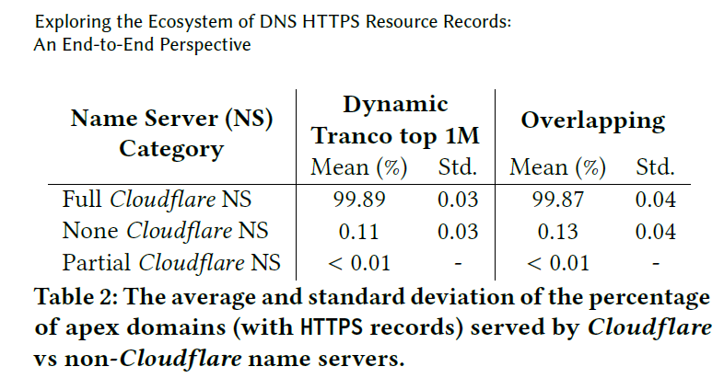
[8]
Notes:
Yu-Siang
This table shows that almost all domains with HTTPS records use Cloudflare name servers in a previous study, meaning that Cloudflare plays a dominant role in enabling HTTPS records and ECH deployment across the network.

Slide 17
Why Do Particular Domains Use These Protocols
To better understand this and ground our speculation, we did our qualitative analysis.
As discussed before, we’ll be looking at the raw extracted data we get from domains, and dividing them by the various values we’re recording, like ECH usage. These domains are then given two category values, site category and desired content.
We’ve begun examining these records, but currently the only available report is on the usage of HTTPS + ECH + DNSSEC.
If possible, other records will be found in our report, due to both presentation and parsing time constraints.
We can still expand on our tentative findings if needed.
Notes:
Alex

Slide 18
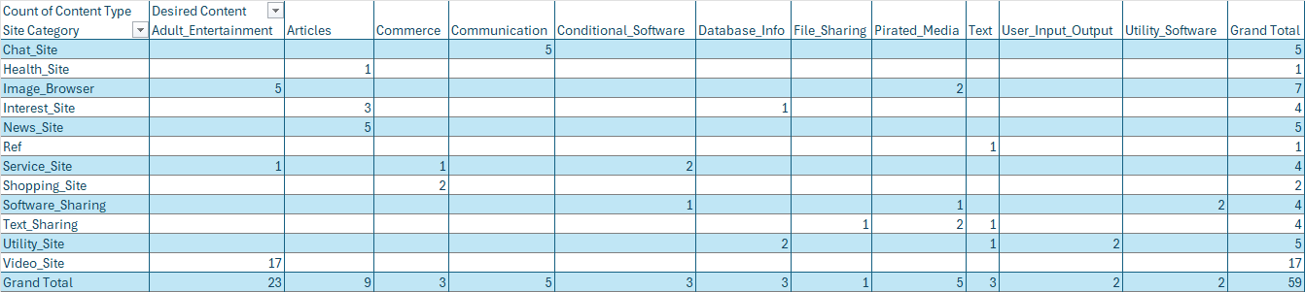
HTTPS + ECH + DNSSEC Pivot Table

Slide 19
HTTPS + ECH + DNSSEC Qualitative Analysis
Adult Entertainment and Pirated Media are among the two largest types of desired content in domains that use HTTPS + ECH + DNSSEC. Reasons probably have to do with ECH’s ability to hide SNI. Adult entertainment can be a taboo subject, while pirated media sites are of a dubious legality, so association is not ideal. That creates an incentive to hide that information from others. Furthermore these sites tend to have targets on their backs, creating another incentive to hide the SNI.
Most categories describe domains that heavily use large media files: video sites, image browsers, articles with large images. That makes them reliant on CDNs for performance, which in turn makes them targets for cache poisoning, the act of injecting malicious data into a cache to control it. DNSSEC’s validator serves as protection against these type of attacks [9].
Notes:
Alex

Slide 20
Conclusion
HTTPS + ECH + DNSSEC can be a difficult to implement suite of protocols. Unless they really benefit from it, most domains will avoid implementing the two options in March 2026, to reduce maintenance difficulty and server load. This is reflected in the top 10,000 domains, who are largely able turn off ECH due to their resources.
Shown in the small tallies for ECH and DNSSEC, especially in tandem.
There still are use cases for these protocols. DNSSEC sees use in heavy security situations like banks, while ECH sees use in privacy contingent situations. Domains in that latter situation, who also use many large media files, are a niche for HTTPS + ECH + DNSSEC, which can provide protection and confidentiality in these scenarios.
Notes:
Richie with Alex interjections

Slide 21
GitHub Repository
Our data collection code, actual data, internal documents, and existing work are available at our GitHub Repository.
https://github.com/RhoAl/CS578-Project-Chain-Link-Security-Data-Files

Slide 22
Citations
[1] “All your DNSSEC base are belong to US,” PwnDefend, https://www.pwndefend.com/2025/11/25/all-your-dnssec-base-are-belong-to-us/ (accessed Mar. 11, 2026).
[2] Chromium, https://issues.chromium.org/issues/40426170#comment23 (accessed Mar. 11, 2026).
[3] A. Kotylevskiy, “DNSSEC: Should you use it? an expert’s view on the pros, cons, and when to implement - netlas blog,” Netlas, https://netlas.io/blog/what_is_dnssec/#:~:text=DNSSEC%20does%20not%20protect%20against,responses%20by%20removing%20DNSSEC%20configuration (accessed Mar. 11, 2026).
[4]Khandkar, V. S., Hanawal, M. K., & Kulkarni, S. G. (2022). Challenges in Adapting ECH in TLS for Privacy Enhancement over the Internet. https://doi.org/10.48550/arxiv.2207.01841
[5] D. Cid, “Encrypted client hello (ECH): Impact on content filtering,” CleanBrowsing, https://cleanbrowsing.org/articles/how-encrypted-client-hello-ech-impacts-content-filtering-solutions-challenges-and-adaptations (accessed Mar. 11, 2026).
[6] “Ech Protocol,” Cloudflare Docs, https://developers.cloudflare.com/ssl/edge-certificates/ech/ (accessed Mar. 11, 2026).
[7] Martino Trevisan, Francesca Soro, Marco Mellia, Idilio Drago, and Ricardo Morla. 2023. Attacking DoH and ECH: Does Server Name Encryption Protect Users’ Privacy? ACM Trans. Internet Technol. 23, 1, Article 19 (February 2023), 22 pages. https://doi.org/10.1145/3570726
[8] Hongying Dong, Yizhe Zhang, Hyeonmin Lee, Shumon Huque, and Yixin Sun. 2024. Exploring the Ecosystem of DNS HTTPS Resource Records: An End-to-End Perspective. In Proceedings of the 2024 ACM on Internet Measurement Conference (IMC '24). Association for Computing Machinery, New York, NY, USA, 423–440.
[9] N. Gul, “How to avoid web cache poisoning attacks,” Snyk, https://snyk.io/blog/how-to-avoid-web-cache-poisoning-attacks/ (accessed Mar. 11, 2026).

Slide 23
Questions?

Slide 24
Thank You!

